Slide 1
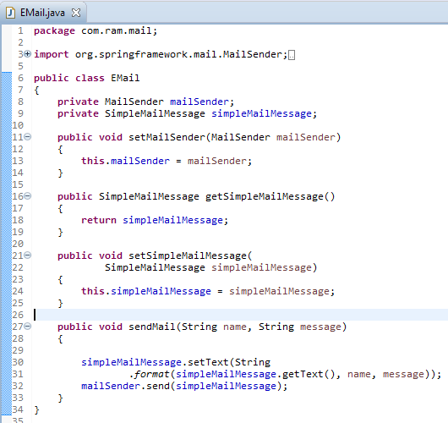
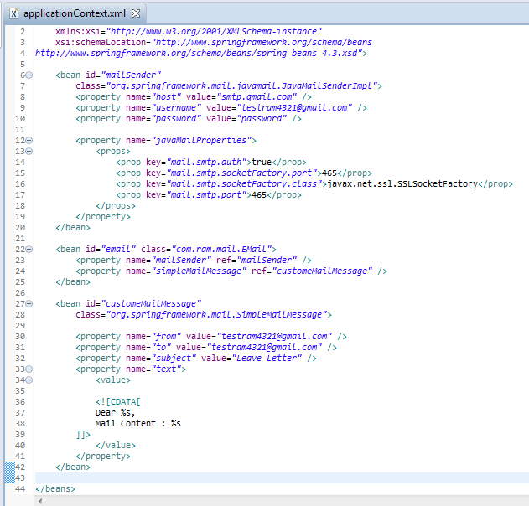
Define an E-mail template in bean configuration file
Define the email template ‘customeMailMessage‘ and
mail sender details in the bean configuration file.

Slide 2
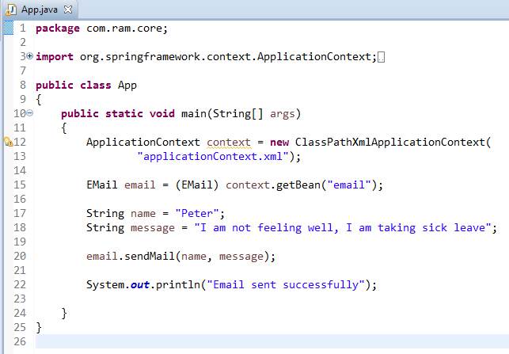
Define an E-mail template in bean configuration file

Slide 3
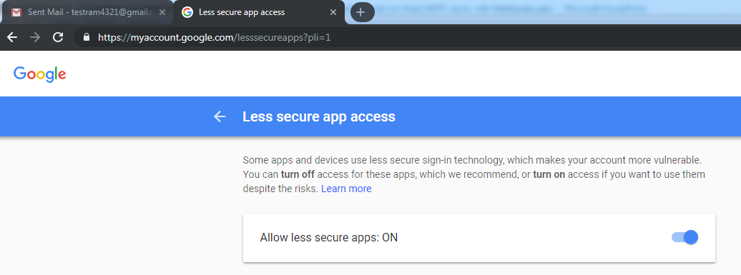
Define an E-mail template in bean configuration file
To resolve javax.mail.AuthenticationFailedException is thrown while sending email in java
Go Login from Your browser from that email. I had problem with google if it is google go here :https://www.google.com/settings/security/lesssecureapps
you will see turn off or turn on. Click "Turn on"
Then try your code again it will work

